Slide 2
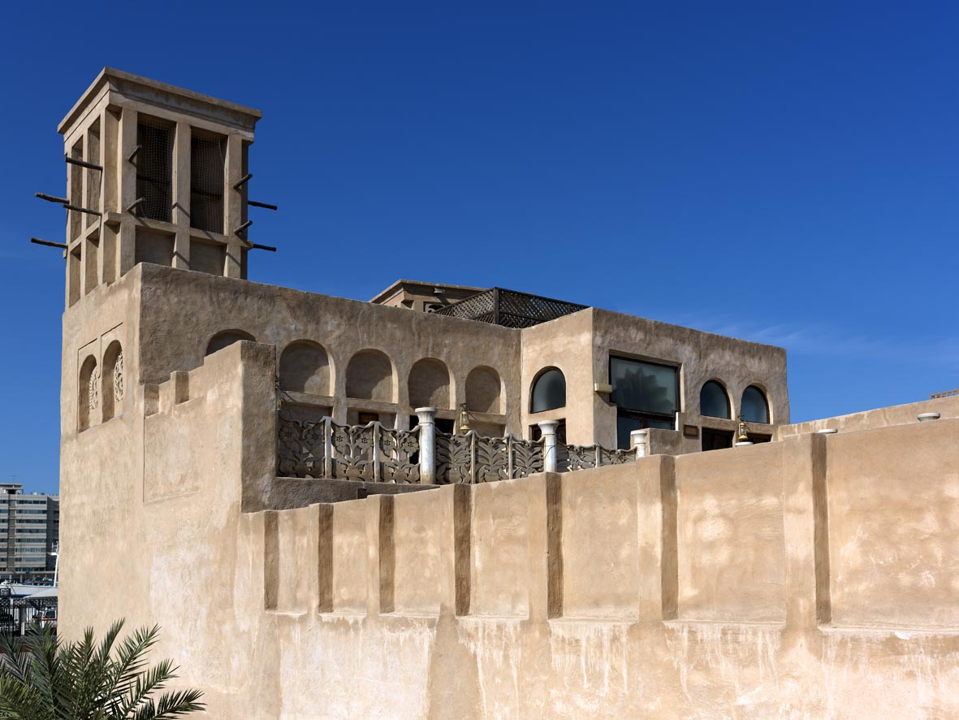
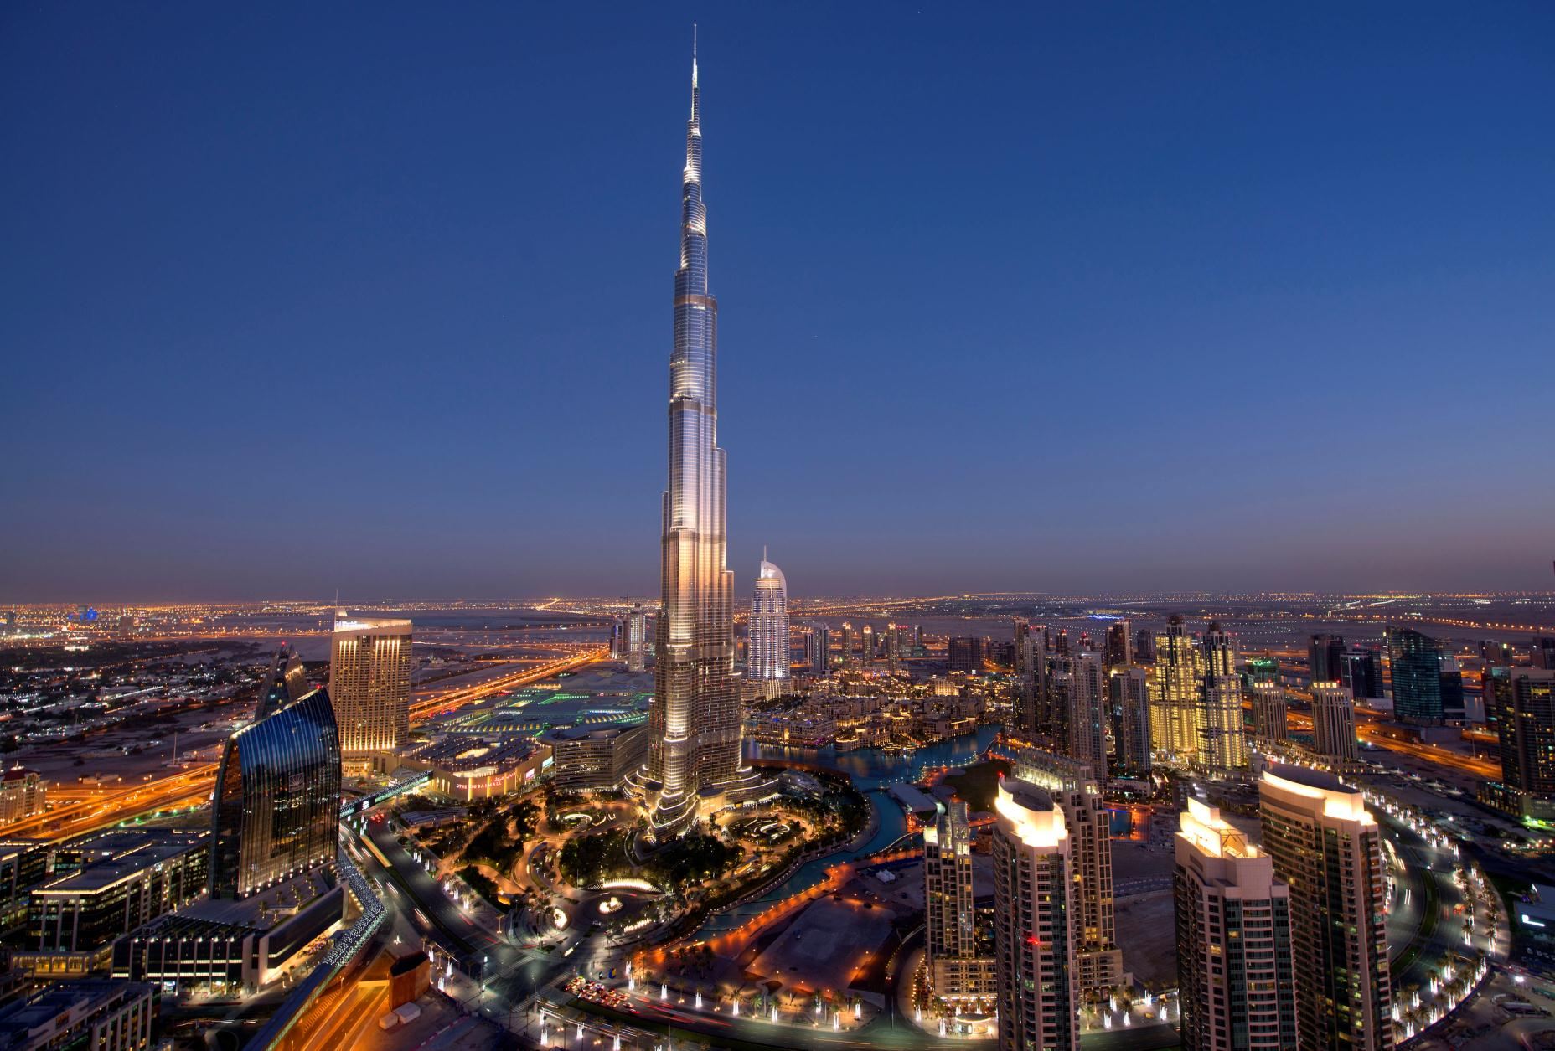
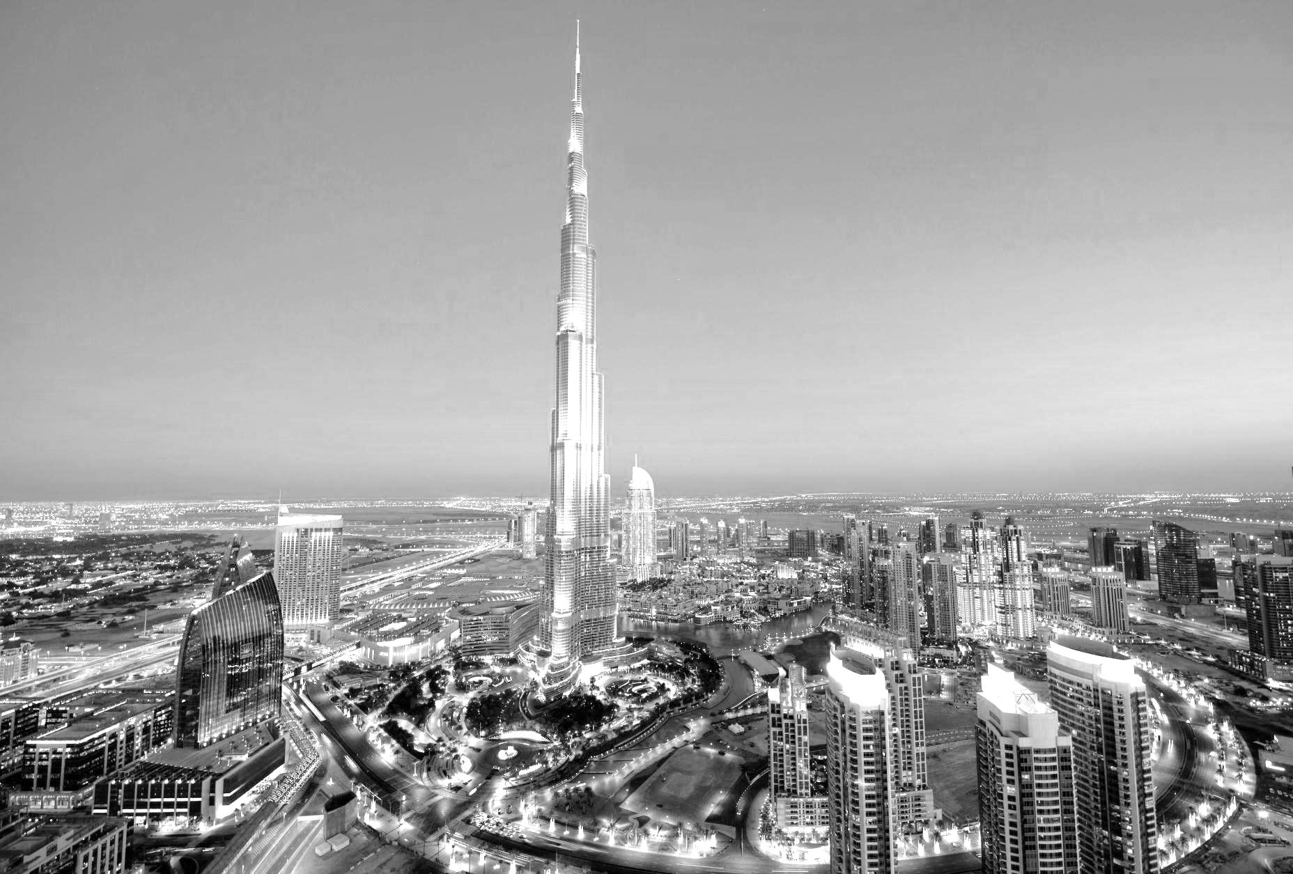

Slide 3
Dubai FDI Canada Mission May 2017

Slide 5
Our Story

Slide 6
Our Story

Slide 7
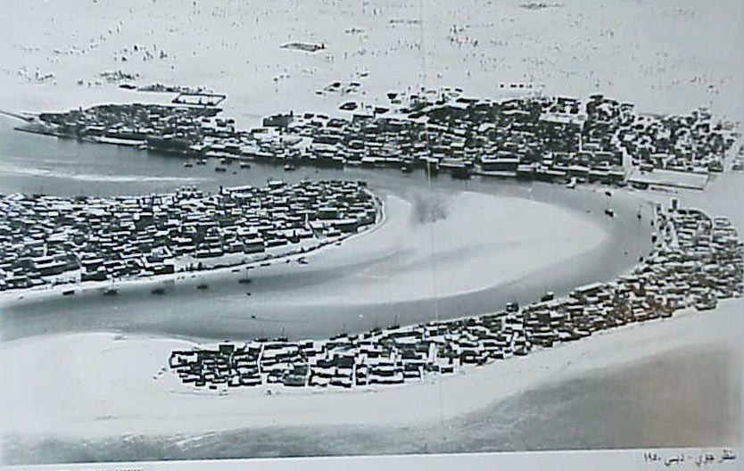
Dubai 1950
Our Story

Slide 8
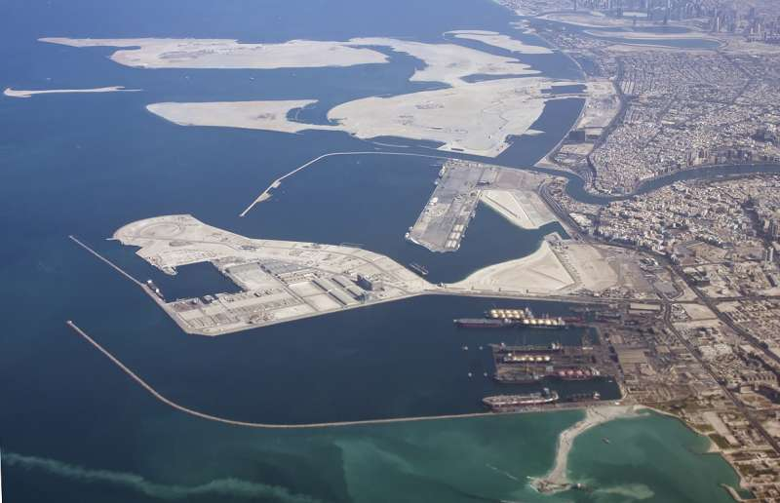
Rashid Port opens
1971 1978 1985 1990 1993 1996 1997 1999 2001
Our Story

Slide 9
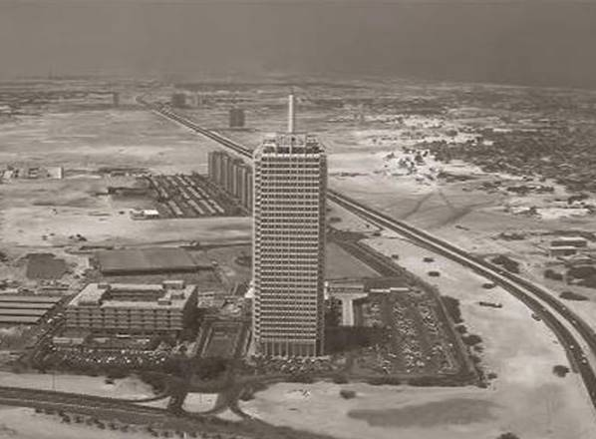
Dubai World Trade Centre opens
1971 1979 1985 1990 1993 1996 1997 1999 2001
Our Story
Tourism Vision

Slide 10
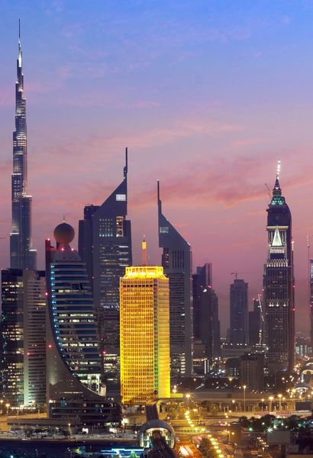
Dubai World Trade Centre

Slide 11
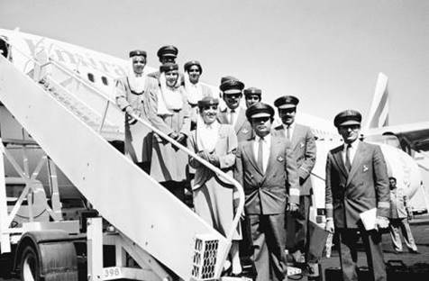
Emirates Airline launched
1971 1978 1985 1990 1993 1996 1997 1999 2001
Our Story
Tourism Vision

Slide 12
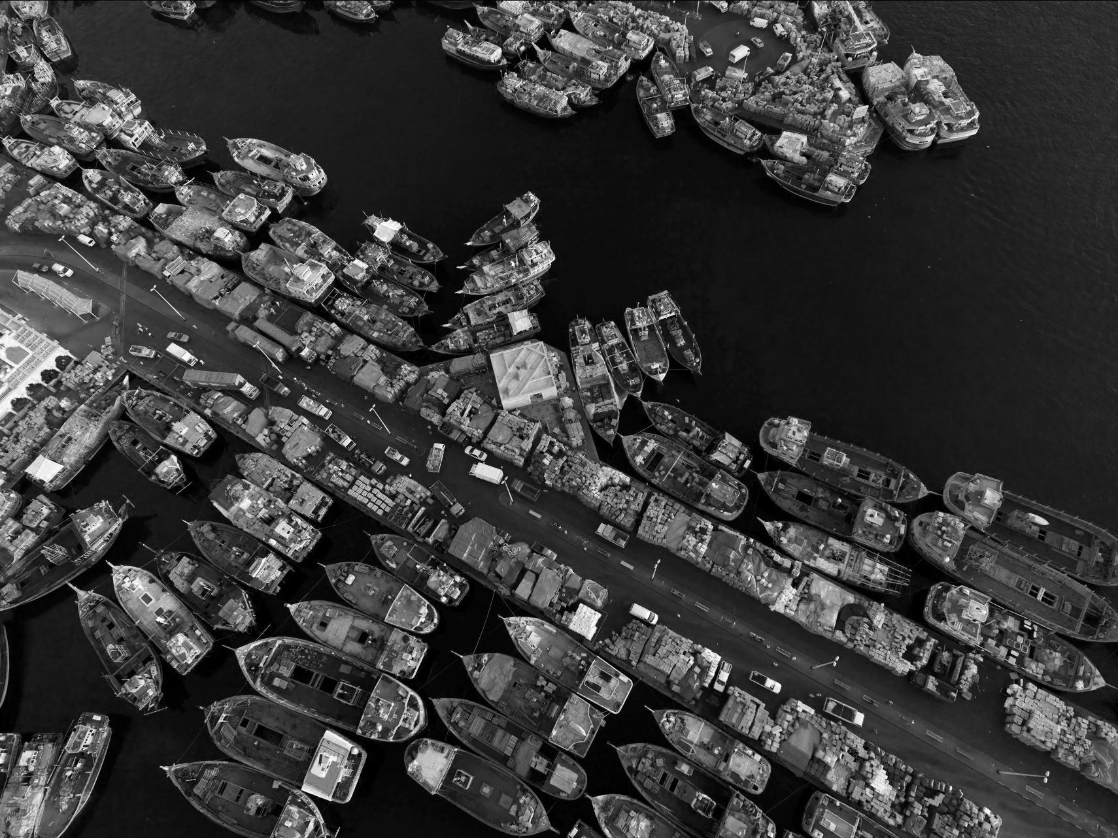
0.6 million
70
5,300
Hotel guests
Hotels
Rooms
1971 1978 1985 1990 1993 1996 1997 1999 2001
Our Story
Tourism Vision

Slide 13
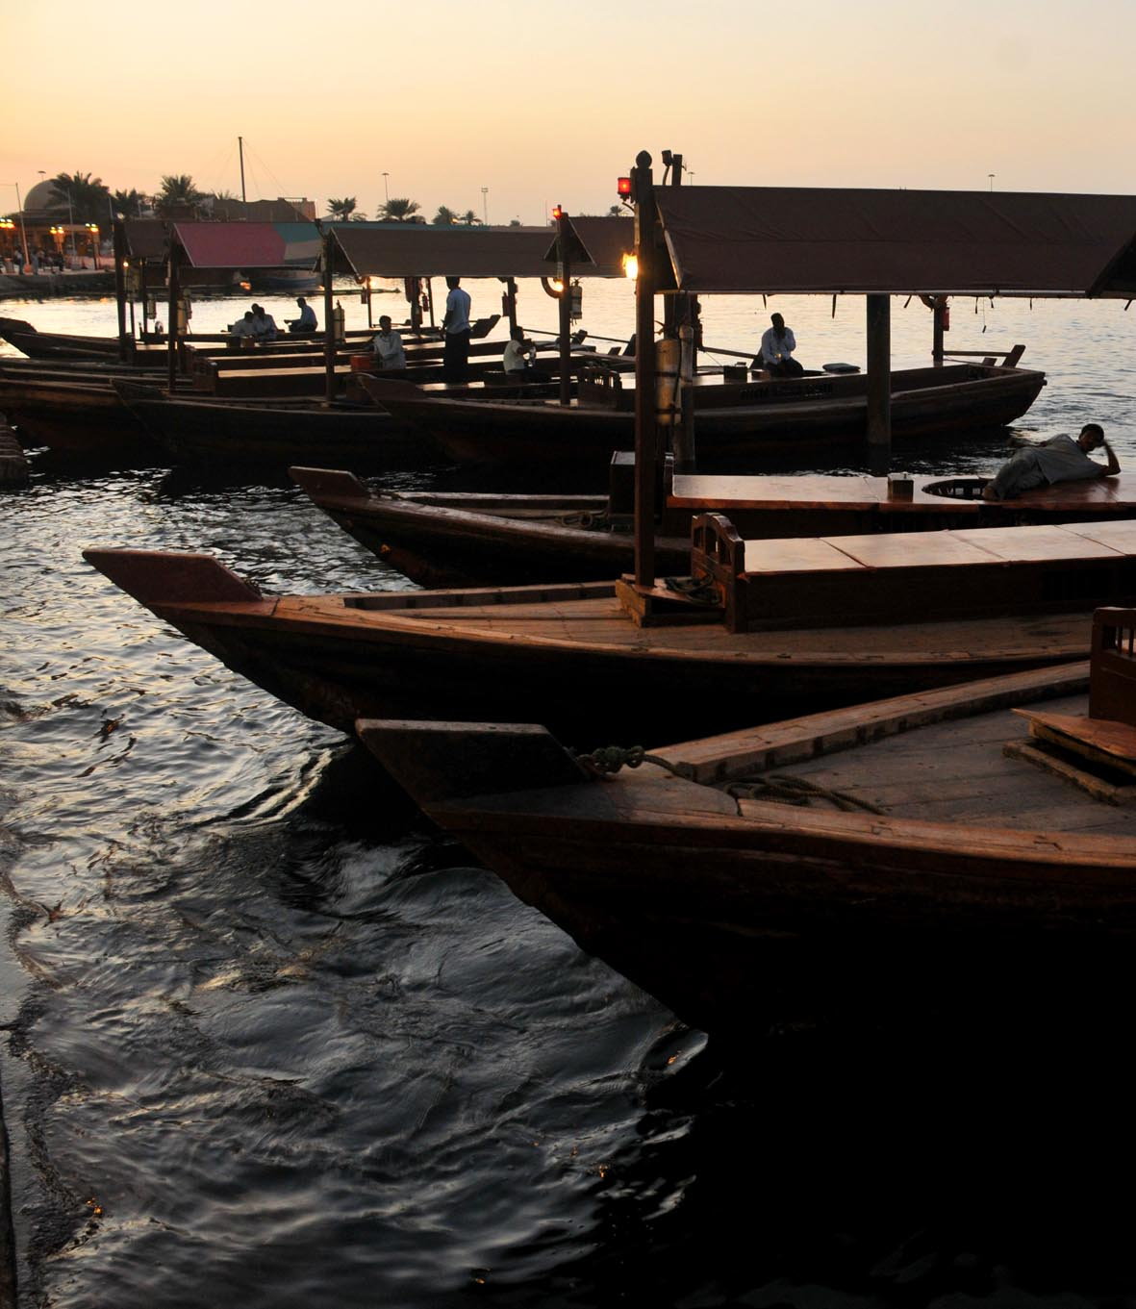
1 million
167
9.300
Hotel guests
Hotels
Rooms
1971 1978 1985 1990 1993 1996 1997 1999 2001
Our Story
Tourism Vision

Slide 14
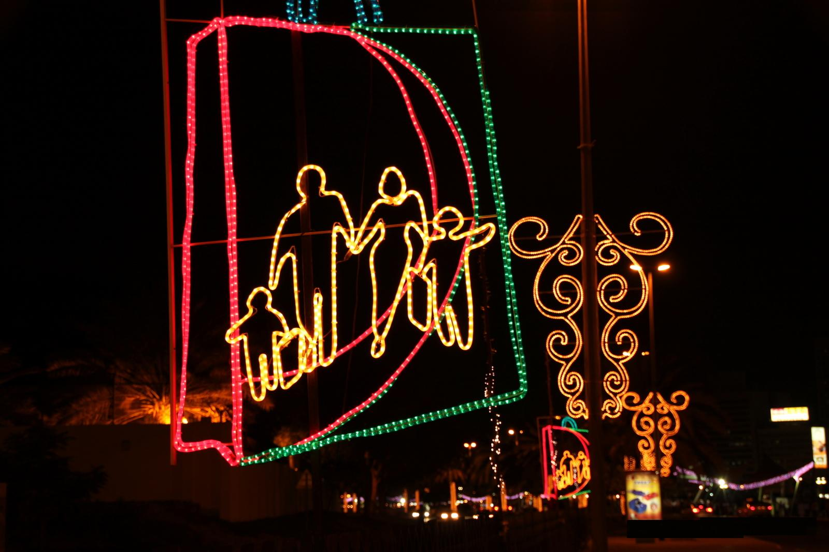
293
1.9 million
15,000
Hotels
Hotel guests
Rooms
Dubai Shopping Festival launched
1971 1978 1985 1990 1993 1996 1997 1999 2001
Our Story
Tourism Vision

Slide 15
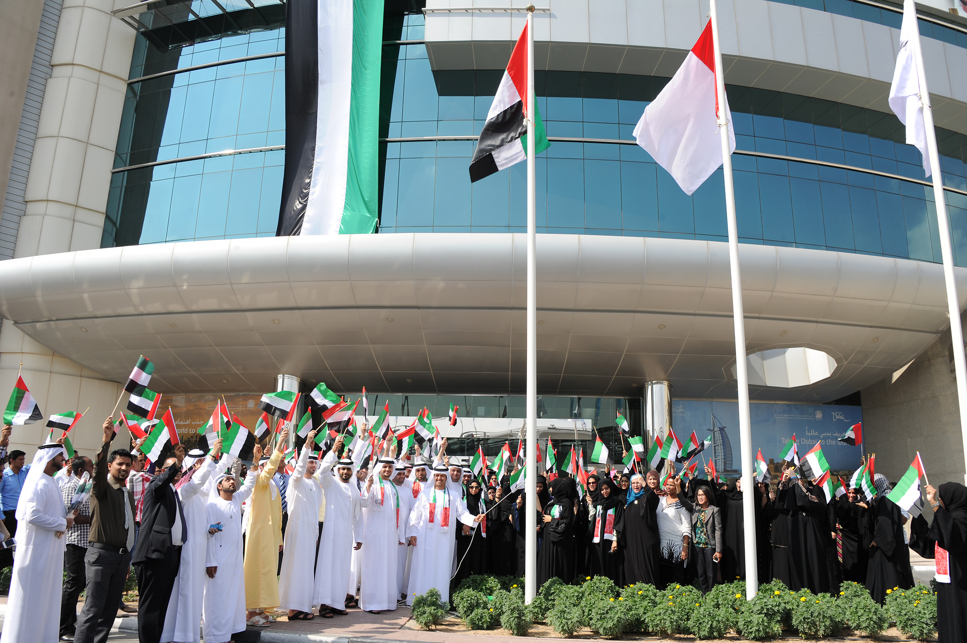
2.1 million
333
17,300
Hotel guests
Hotels
Rooms
Department of Tourism and Commerce
Marketing (DTCM) launched
1971 1978 1985 1990 1993 1996 1997 1999 2001
Our Story
Tourism Vision

Slide 16
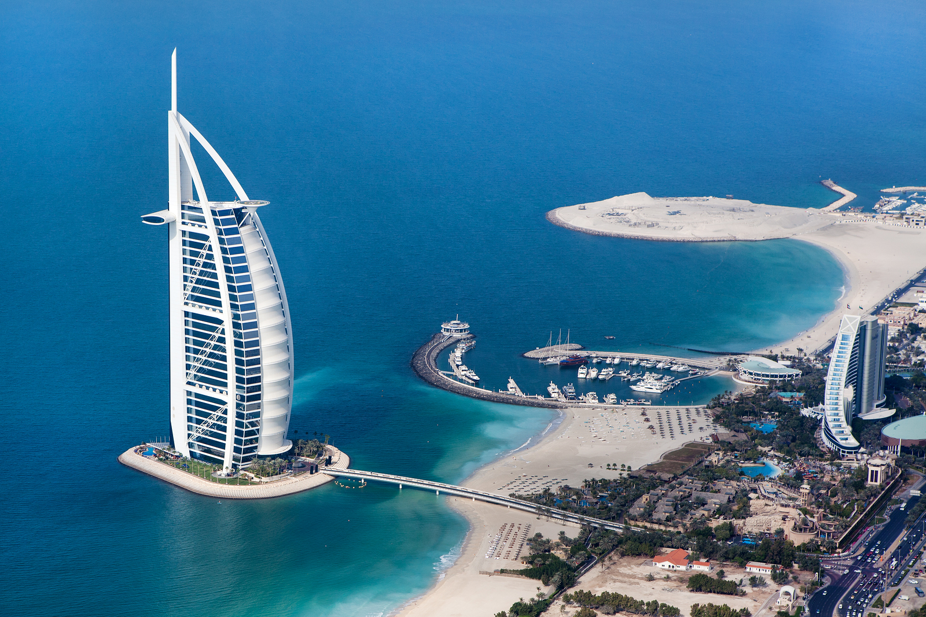
3 million
25,000
378
Hotel guests
Rooms
Hotels
Burj Al Arab opens
1971 1978 1985 1990 1993 1996 1997 1999 2001
Our Story
Tourism Vision

Slide 17
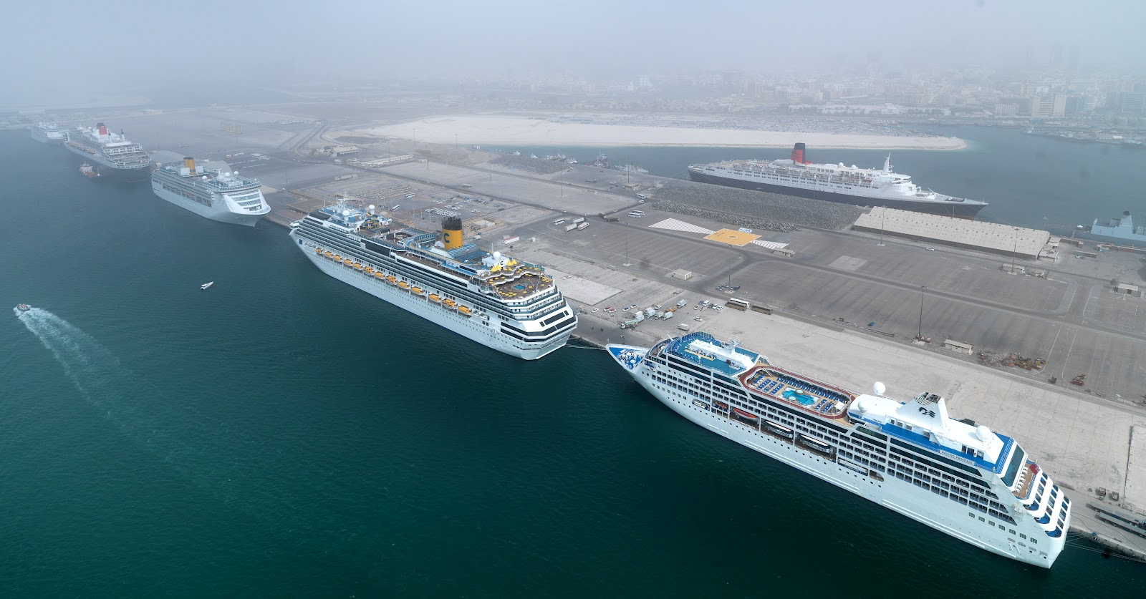
3.6 million
471
28,500
Hotel guests
Hotels
Rooms
Dubai Cruise Terminal opens
1971 1978 1985 1990 1993 1996 1997 1999 2001
Our Story
Tourism Vision

Slide 18
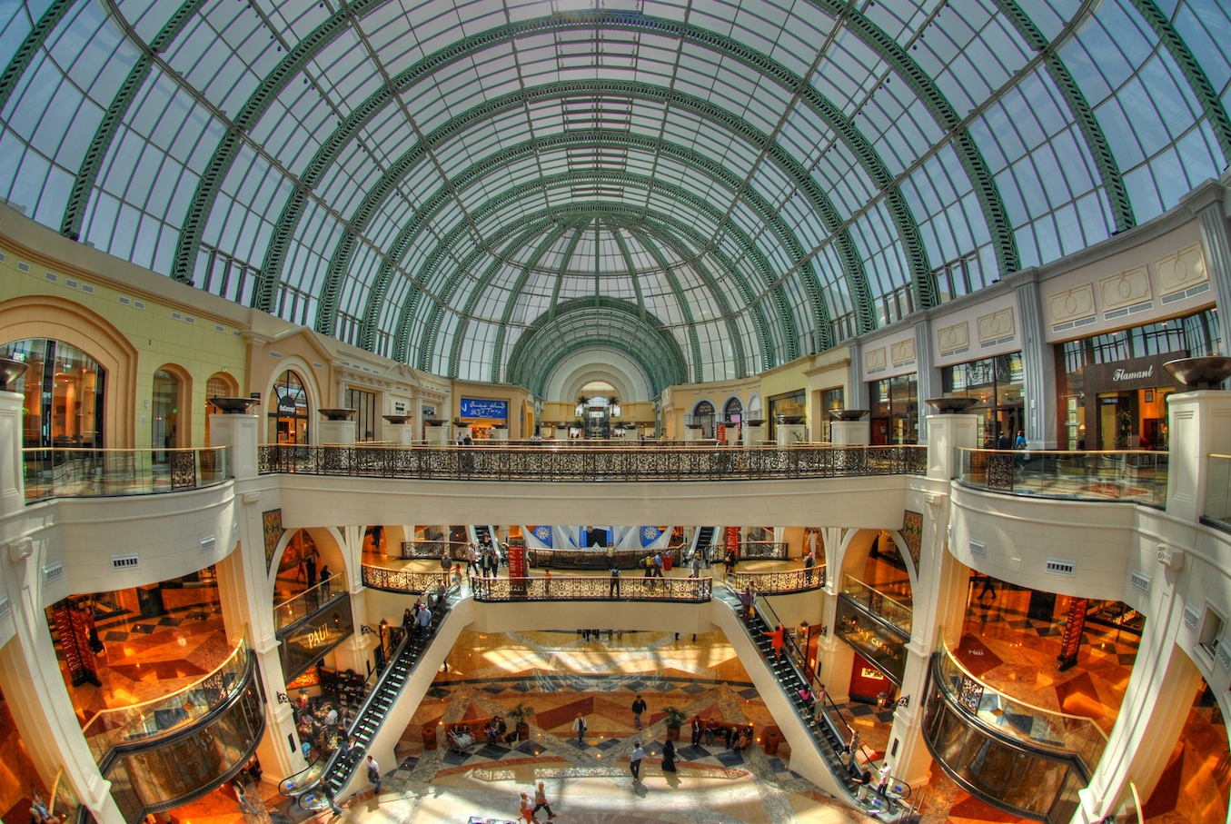
6.1 million
407
38,200
Hotel guests
Hotels
Rooms
Mall of the Emirates opens
2004 2005 2006 2008 2009 2010 2012 2013 2014
Our Story
Tourism Vision

Slide 19
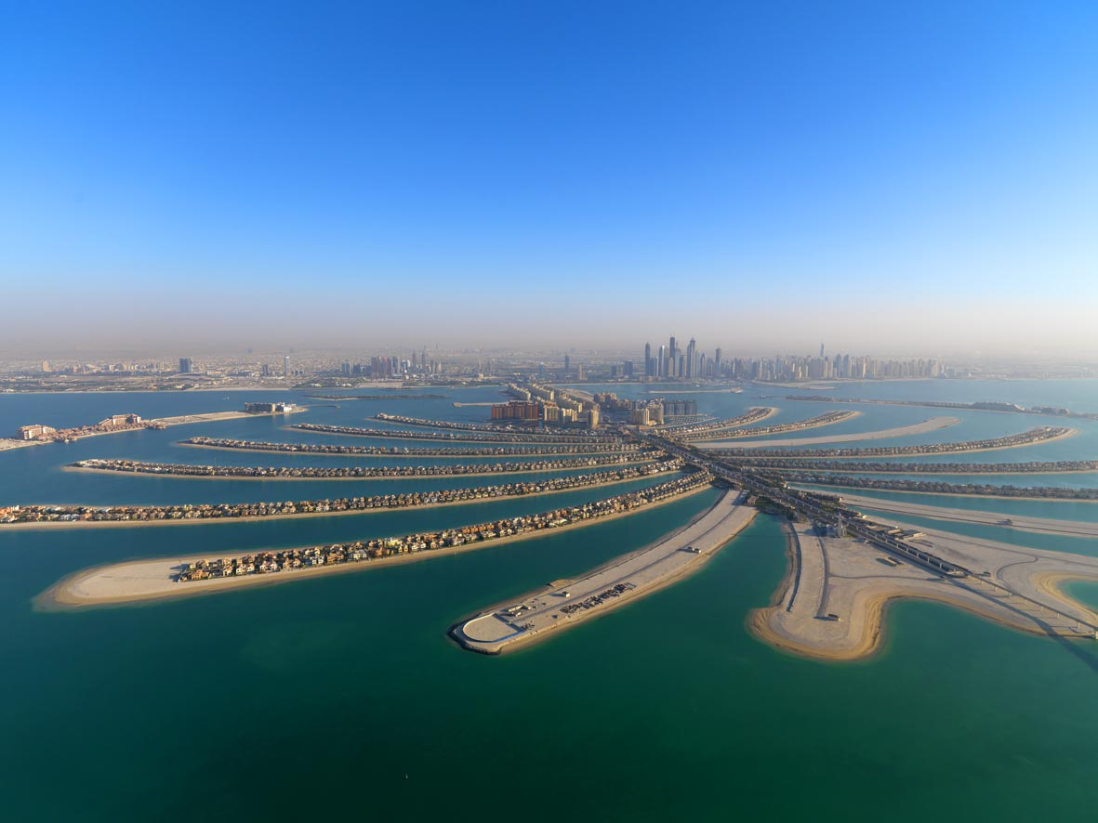
6.4 million
423
40,000
Hotel guests
Hotels
Rooms
First residents move onto Palm Jumeirah
2004 2005 2006 2008 2009 2010 2012 2013 2014
Our Story
Tourism Vision

Slide 20
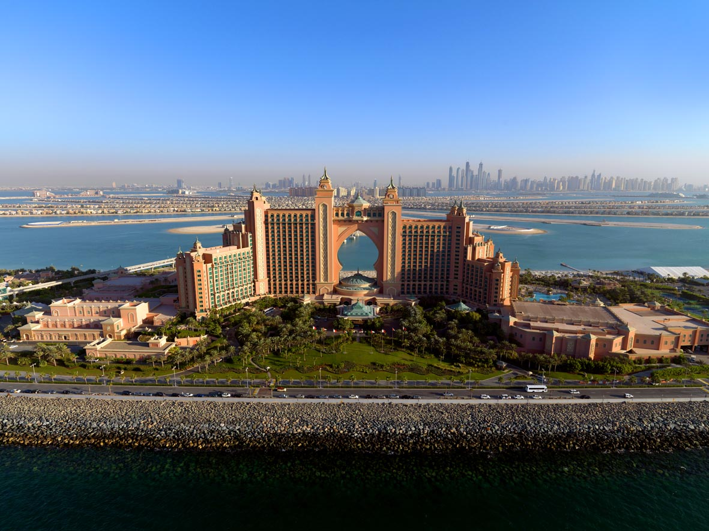
7.5 million
519
56,600
Hotel guests
Hotels
Rooms
Atlantis The Palm opens
flydubai launched
The Dubai Mall opens
2004 2005 2006 2008 2009 2010 2012 2013 2014
Our Story
Tourism Vision

Slide 21
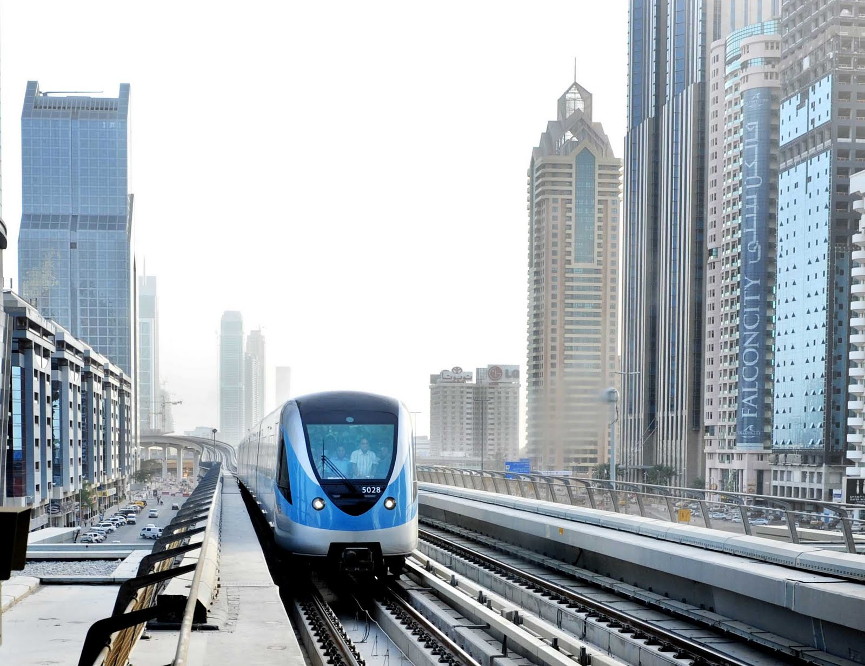
7.58 million
540
61,400
Hotel guests
Hotels
Rooms
Dubai Metro opens
2004 2005 2006 2008 2009 2010 2012 2013 2014
Our Story
Tourism Vision

Slide 22
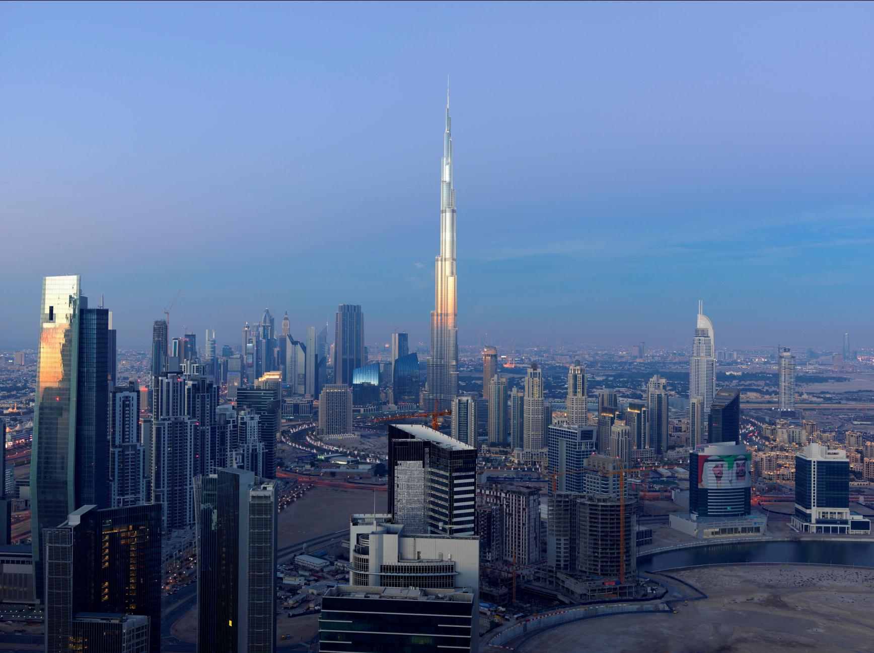
8.3 million
573
70,900
Hotel guests
Hotels
Rooms
Burj Khalifa opens
2004 2005 2006 2008 2009 2010 2012 2013 2014
Our Story
Tourism Vision

Slide 23
9.9 million
599
80,400
Hotel guests
Hotels
Rooms
2004 2005 2006 2008 2009 2010 2012 2013 2014
Our Story
Tourism Vision

Slide 24
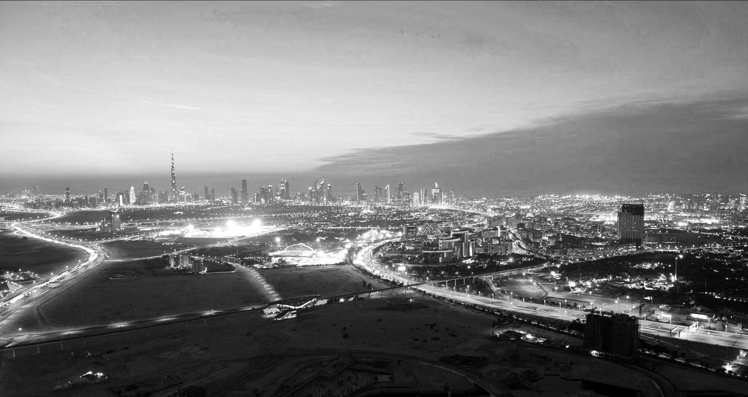
11 million
610
84,600
Hotel guests
Hotels
Rooms
Tourism Vision 2020 announced
Dubai wins Expo 2020 bid
2004 2005 2006 2008 2009 2010 2012 2013 2014
Our Story
Tourism Vision

Slide 25
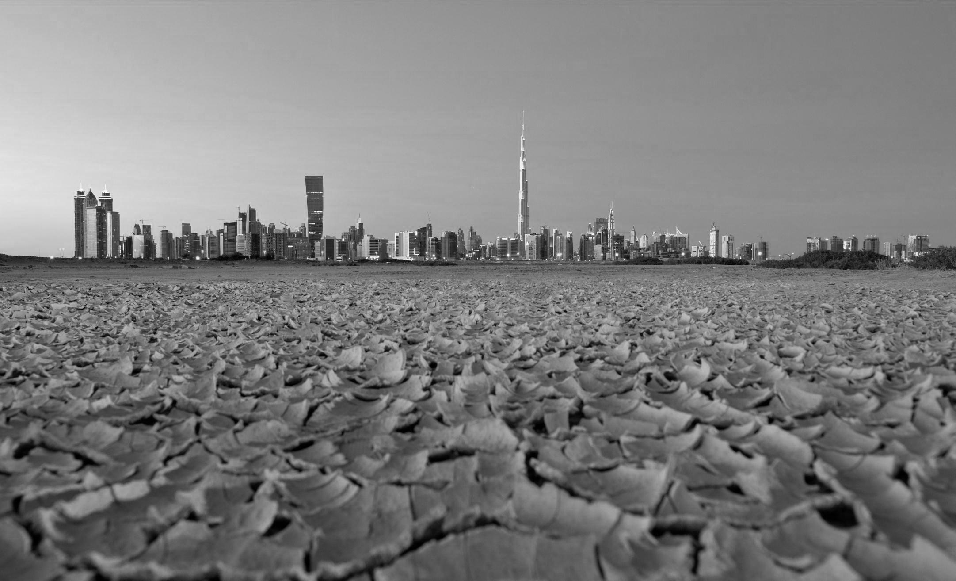
11.6 million
657
92,333
Hotel guests
Hotels
Rooms
#MyDubai initiative launched
2004 2005 2006 2008 2009 2010 2012 2013 2014
Our Story
Tourism Vision

Slide 26
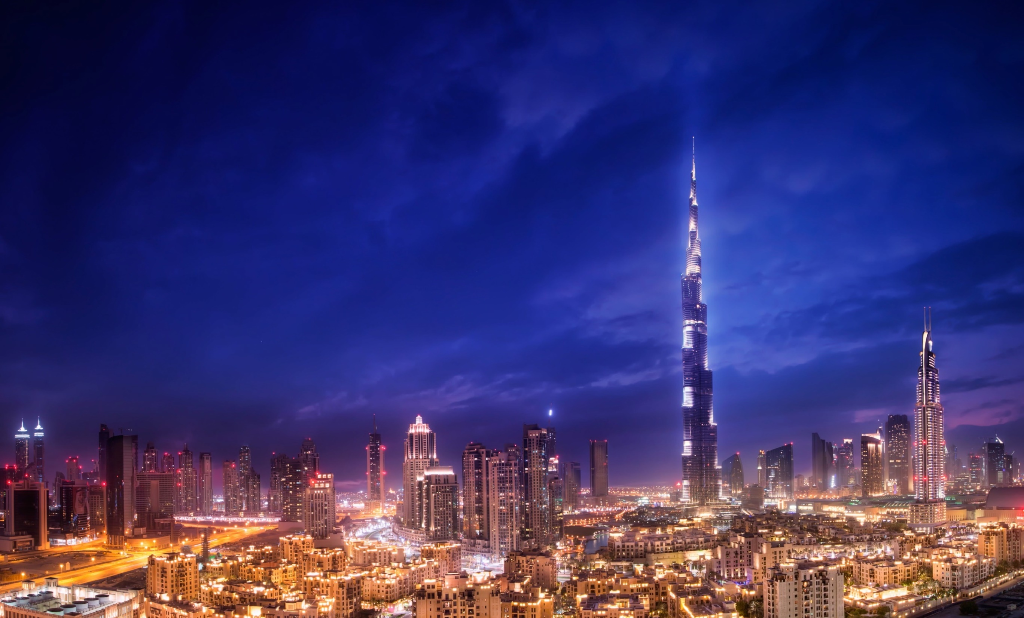
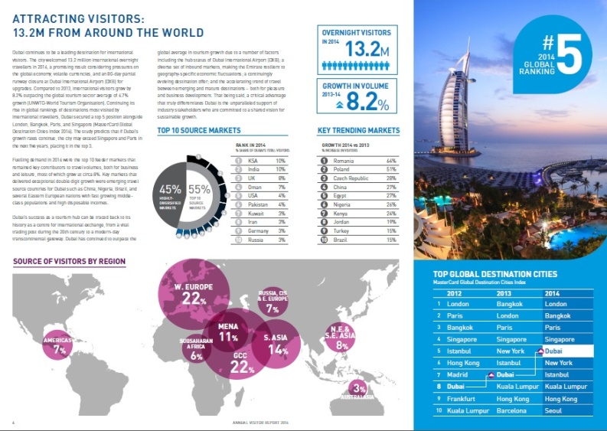
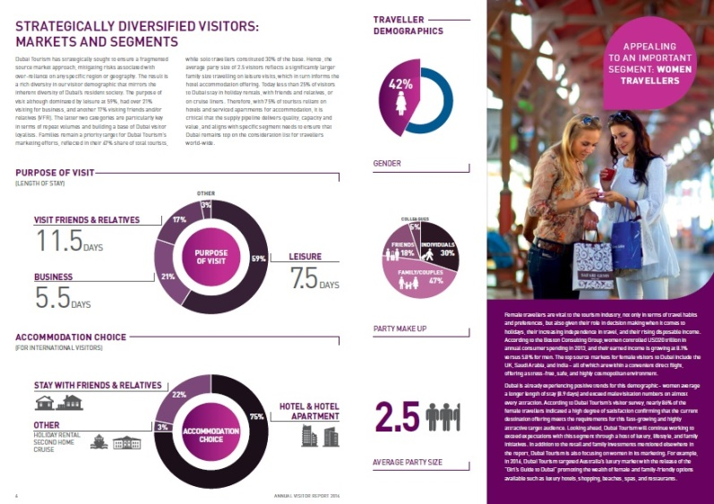
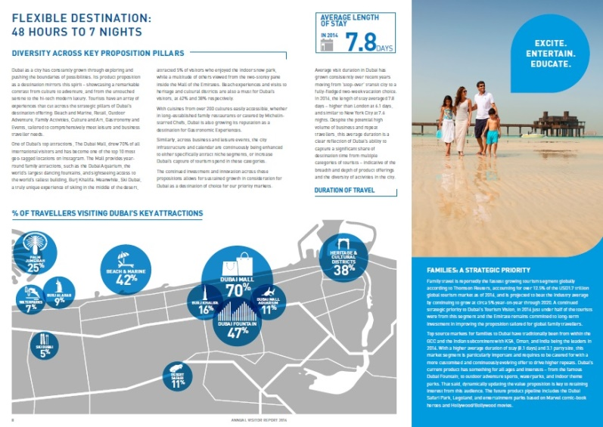
Annual Visitor Report 2014 published
Collation of key tourism metrics, trends and insights
HEADLINE STATISTIC:
13.2m international overnight visitors
Includes all visitors travelling by air, sea and land
Includes those visiting friends and relatives
Excludes UAE residents and air and sea crews
Excludes same-day visitors
2015 2016 2017 2018 2019 2020…
Our Story
Tourism Vision

Slide 27
Tourism Vision

Slide 28
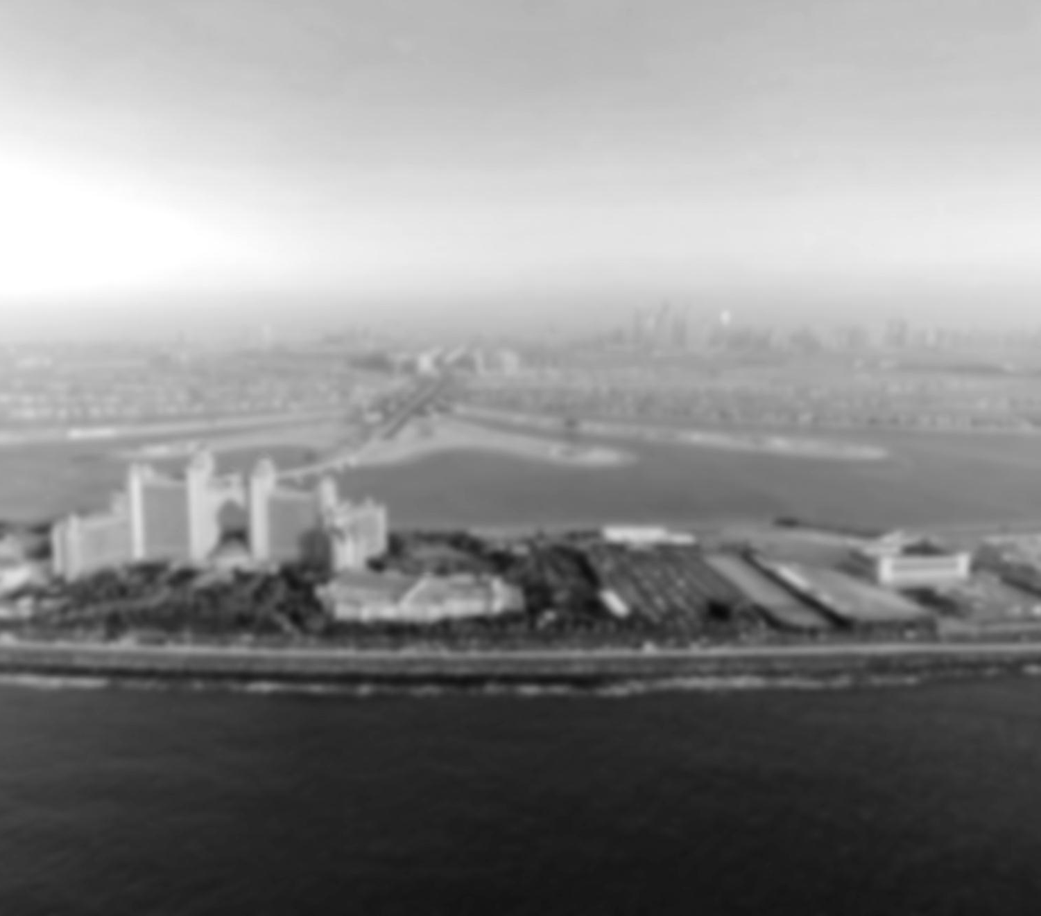
Tourism Vision
Vision
Vision
Tourism Vision

Slide 29
X2
X2
X2
X2
X2
X2
X2
X2
X2
X2
X2
X2
X2
X2
X2
X2
X2
X2
X2
X2
X2
X2
X2
X2
X2
X2
X2
X2
X2
X2
X2
X2
20 MILLION
visitors per year by 2020 – doubling the 10 million welcomed in 2012
2020 Objectives
Tourism Vision

Slide 30
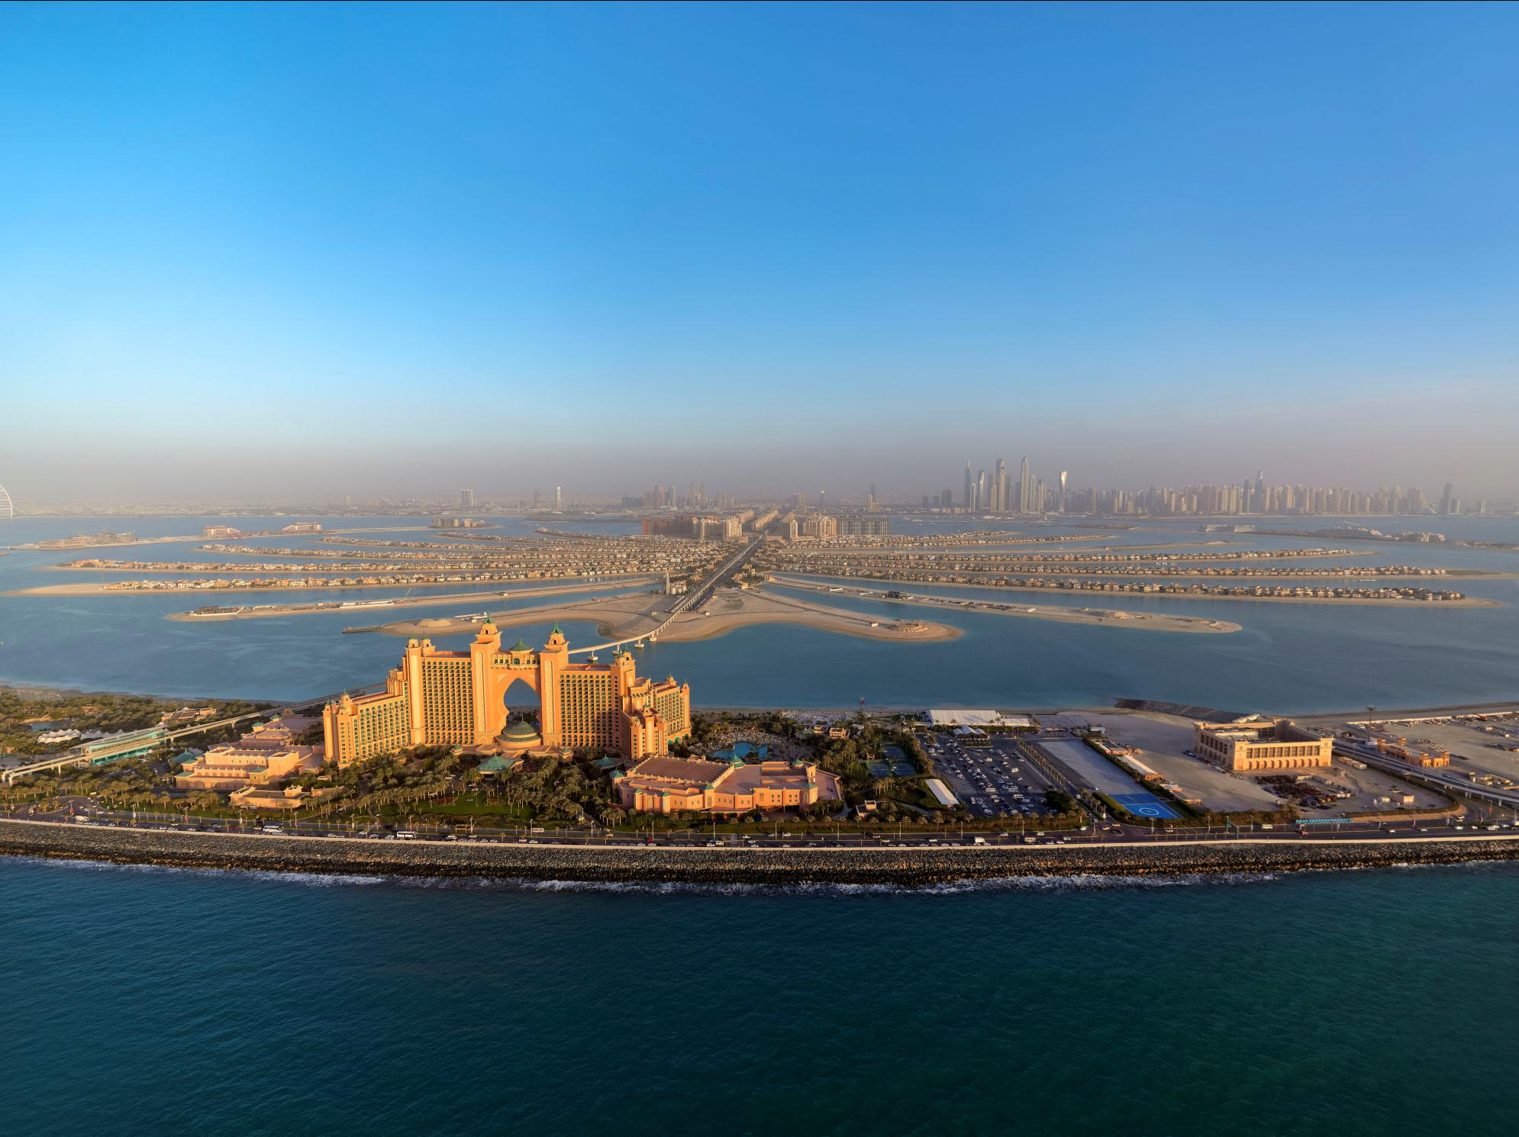
Maintain market share across existing source markets
Grow market share across markets and segments with high growth potential
Capture transit traffic and increase number of repeat visitors
Encourage visitors to stay longer
Encourage visitors to spend more
2020 Objectives
Tourism Vision

Slide 31
Tourism Vision

Slide 32
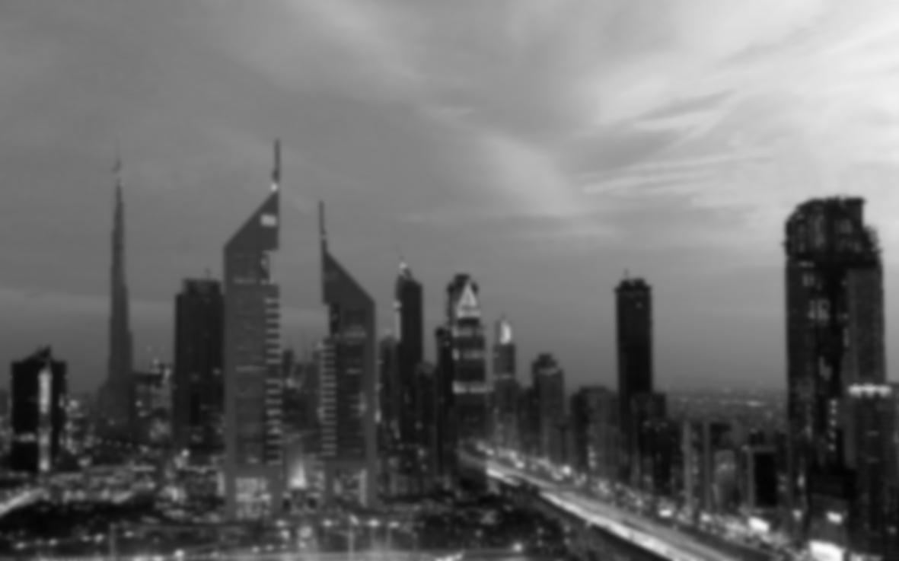
Where we are now
Where We Are Now
Tourism Vision

Slide 33
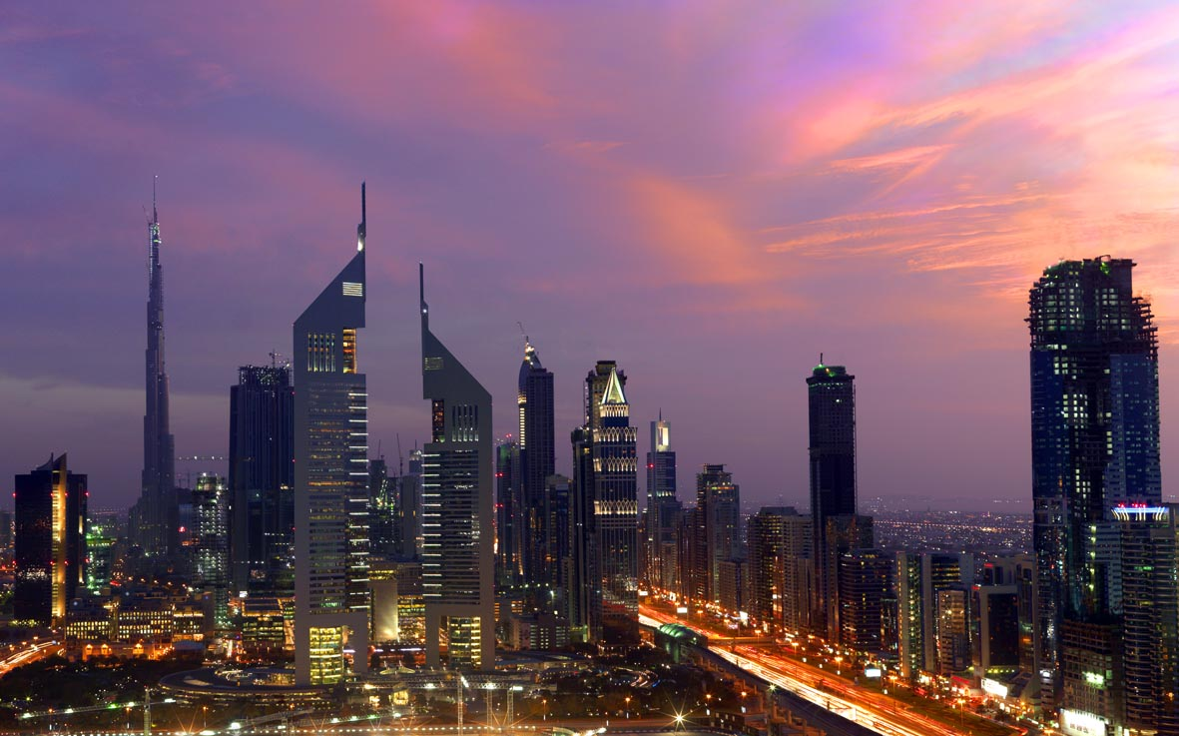
The first World Expo in MENASA region
25 million total visits expected over 6 months – with 70% expected to be international visitors
Total site size: 438 hectares
Gated exhibition area: 200 hectares – able to accommodate 250,000 people per day
Where We Are Now
Tourism Vision

Slide 34
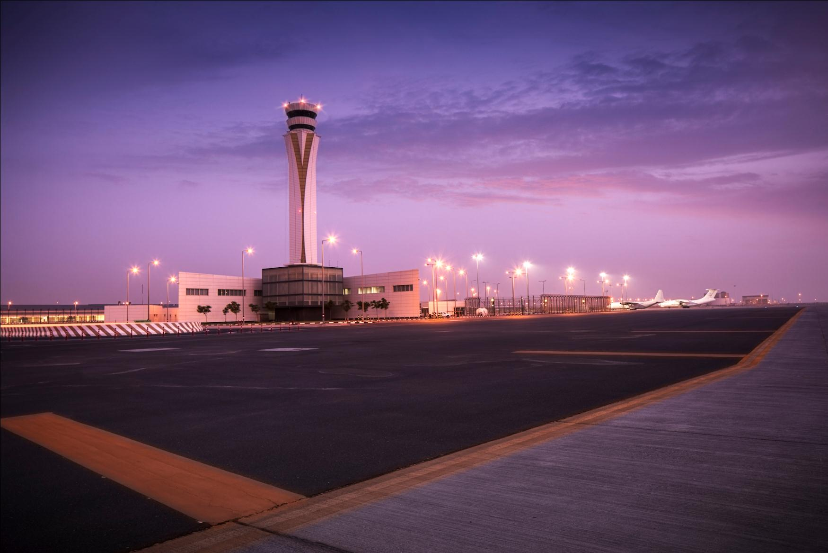
Phase one opened Oct 2013
Passenger terminal to accommodate 26 million passengers per year by 2017
Ultimate capacity of 200 million passengers per year
Where We Are Now
Tourism Vision

Slide 35
Average
length of stay
13,200,000
International
overnight
visitors
7.8 days
8.2%
4.7%
Dubai in 2014
Year-on-year
increase
Global average
International Overnight Visitors
Tourism Vision

Slide 36
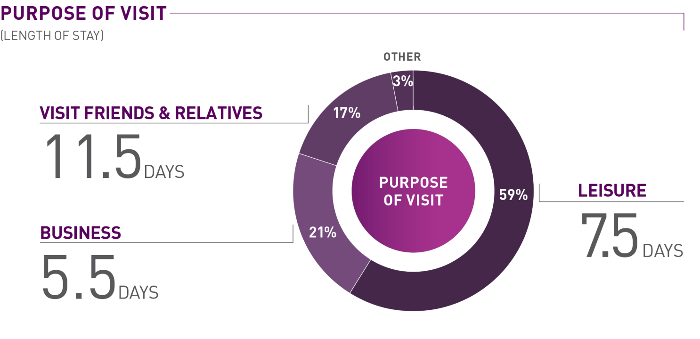
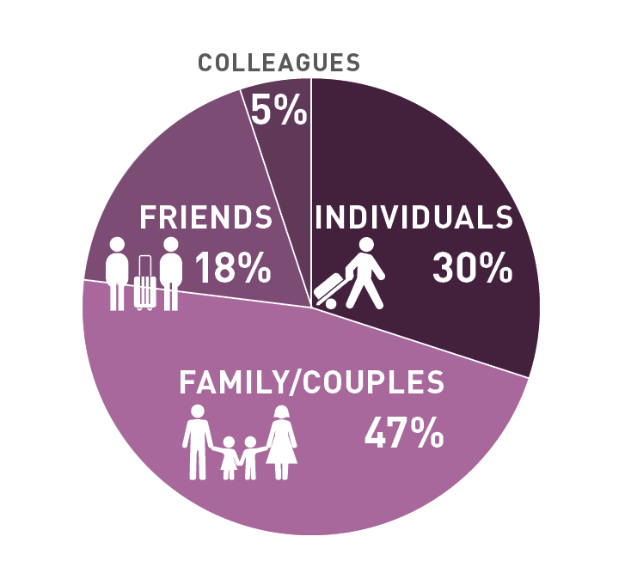
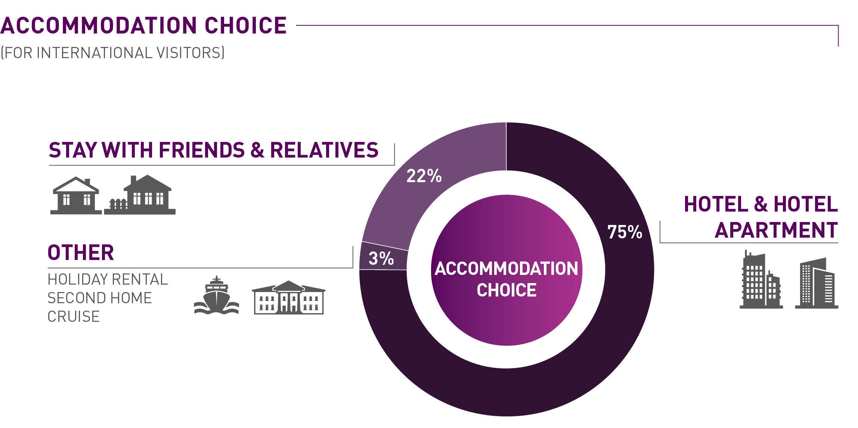
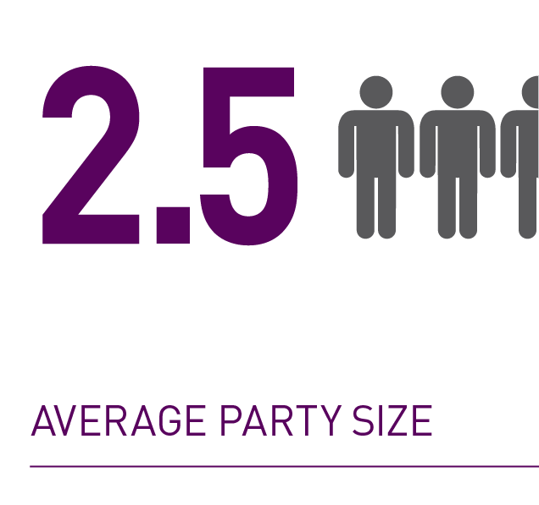
Visitor Demographics
Tourism Vision

Slide 37
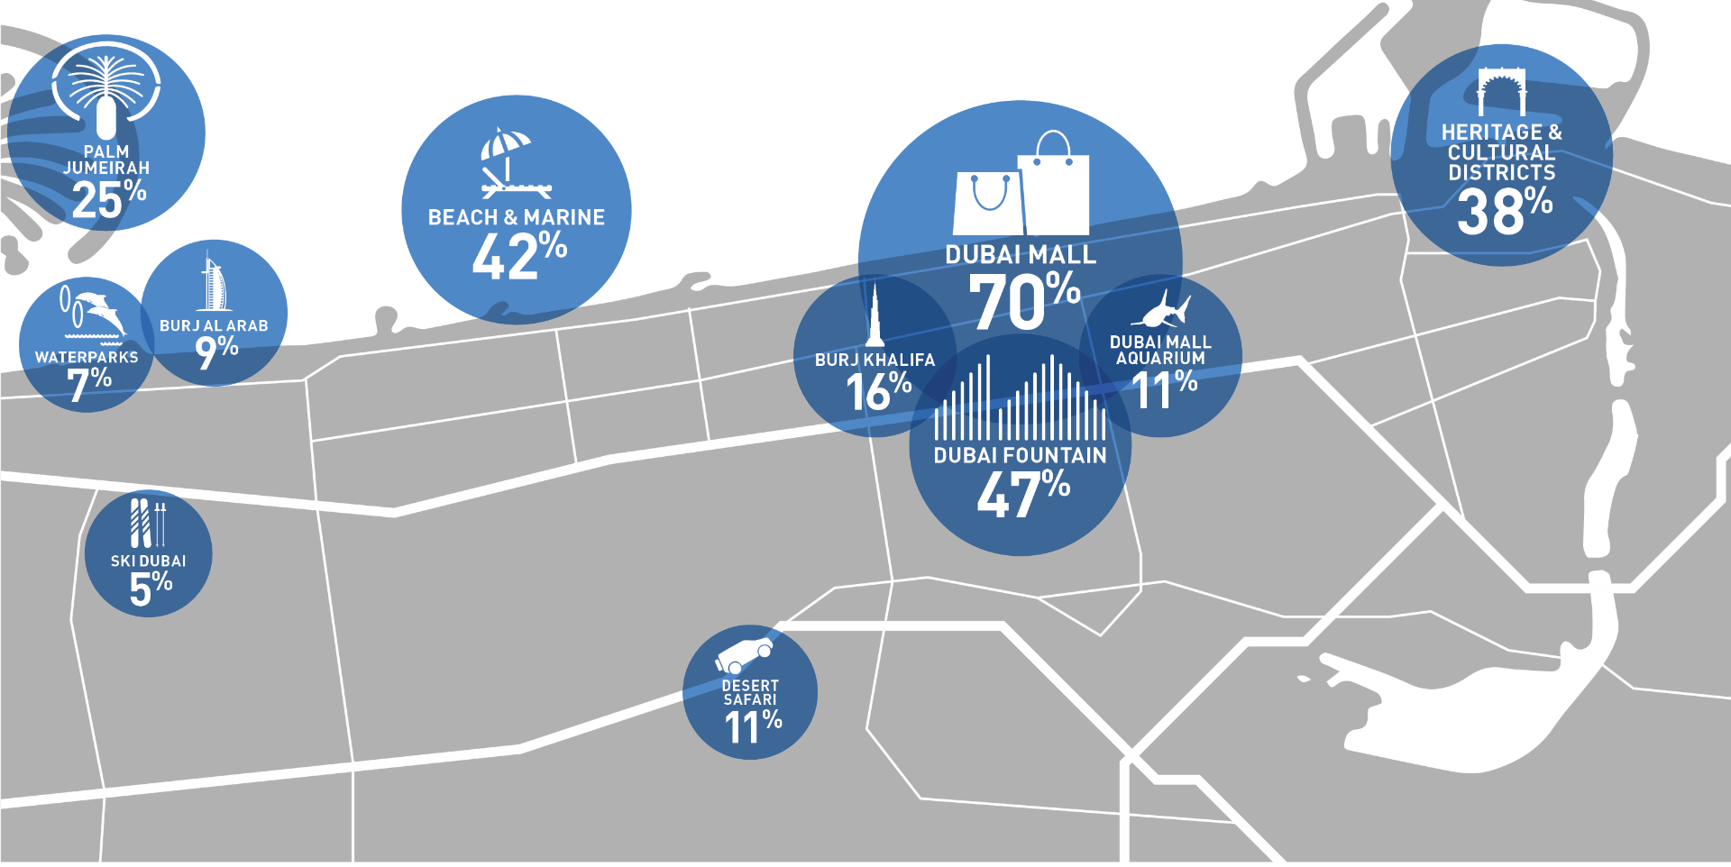
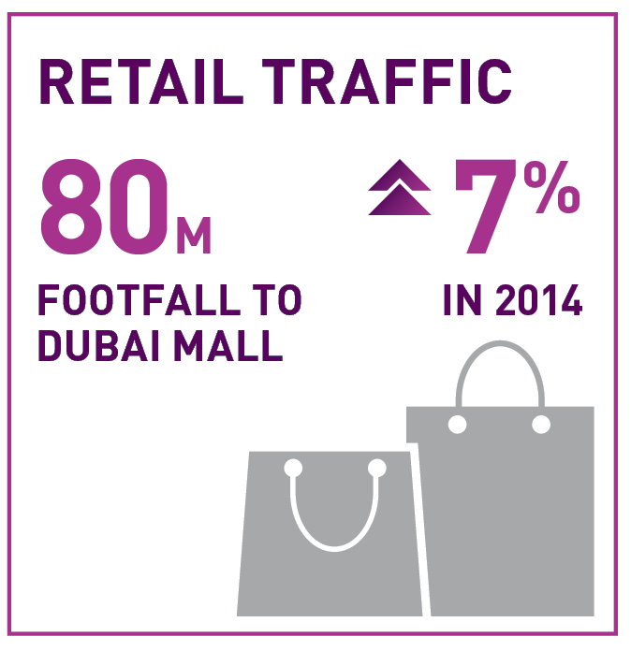
% of travellers visiting key attractions
Visitor Attractions
Tourism Vision

Slide 38
11,629,578
Hotel guests
5.6%
increase
11,012,487
Hotel guests
2013
2014
Hotel Establishment Guests
Tourism Vision

Slide 39
3.84 days
2014
44,663,362
guest nights
7.4%
increase
41,578,768
guest nights
2013
2014
3.78 days
2013
Hotel Guest Nights
Tourism Vision

Slide 40
AED 15.27 billion
12%
increase
AED 13.63 billion
2013
2014
Hotel Room Revenue
Tourism Vision

Slide 41
AED 8.72 billion
6.1%
increase
AED 8.22 billion
2013
2014
Hotel F&B and
Other Revenue
Tourism Vision

Slide 42
AED 23.98 billion
2014
9.8%
increase
AED 21.84 billion
2013
Hotel Total Revenue
Tourism Vision

Slide 43
Number of Hotels
& Hotel Apartments
611
2013
657
2014
Total Room Stock 84,534
Total Room Stock 92,333
46
more
establishments
7,799
more rooms
Hotel Inventory
Tourism Vision

Slide 44
Global Top 5 Cities: Hotel Performance KPIs
Hotel occupancy
Avg. daily rate (AED)
RevPAR (AED)
DUBAI
86%
983
845
SINGAPORE
82.2%
782
642
BANGKOK
80.4%
385
310
LONDON
75.1%
709
532
PARIS
67.8%
917
622
Hotel Performance KPIs
Tourism Vision

Slide 45
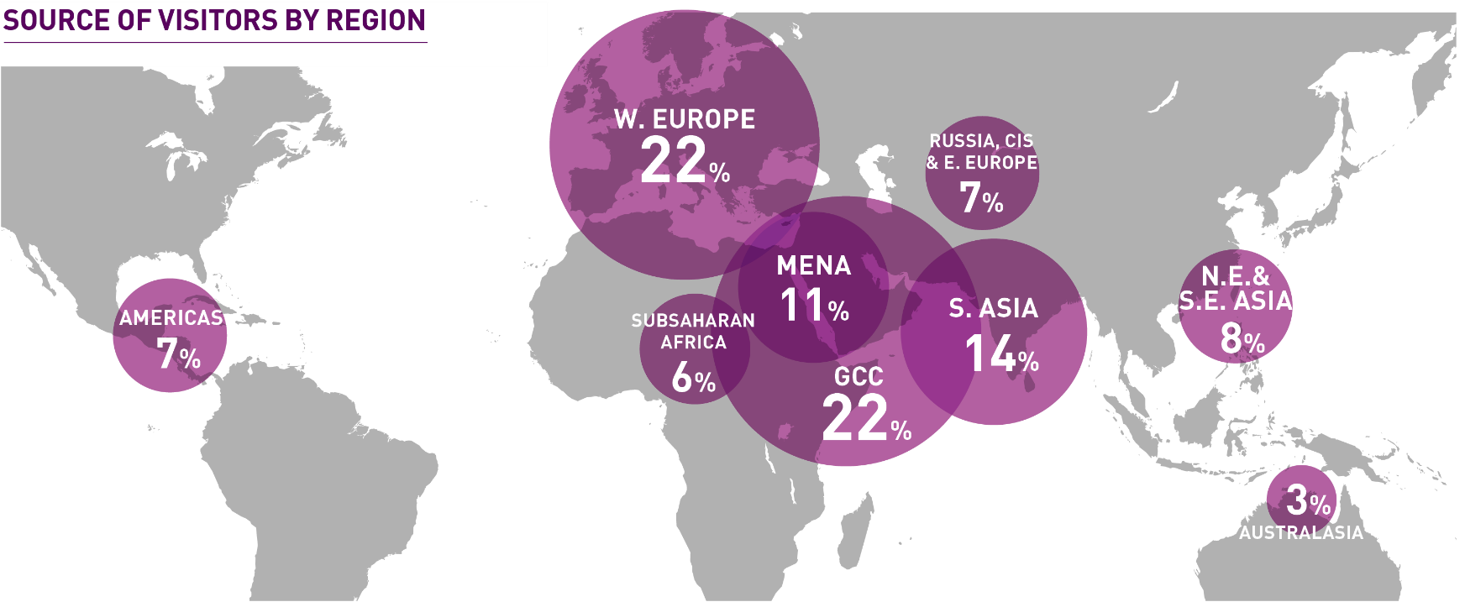
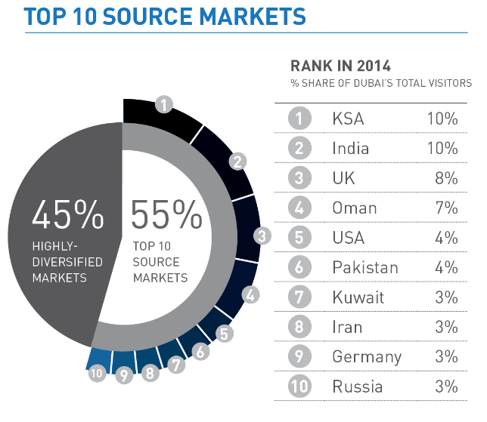
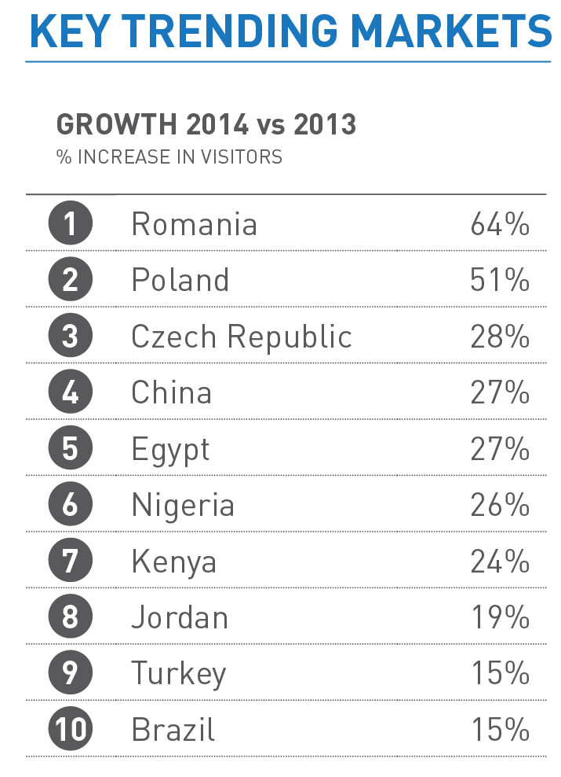
2014 Visitor Source Markets
Tourism Vision

Slide 46
W. Europe
Russia, CIS & E. Europe
21%
5%
GCC
23%
Americas
MENA
S. Asia
N. Asia & S.E. Asia
7%
12%
16%
8%
Africa
5%
Australasia
3%
India
Saudi Arabia
UK
Oman
USA
Pakistan
China
Iran
Germany
Kuwait
Philippines
Egypt
Australia
France
Qatar
Russia
Italy
Canada
Nigeria
Jordan
2016 Visitor Source Markets
Tourism Vision

Slide 47
9
3
10
15
4
17
20
8
5
19
11
7
13
6
1
18
2
16
14
#1 Saudi Arabia
#2 India
#3 UK
#4 USA
#5 Iran
#6 Oman
#7 China
#8 Kuwait
#9 Russia
#10 Germany
#11 Pakistan
#12 Australia
#13 Egypt
#14 Nigeria
#15 France
#16 Philippines
#17 Italy
#18 Qatar
#19 Jordan
#20 Lebanon
12
Hotel Guest Source Markets
Tourism Vision

Slide 48
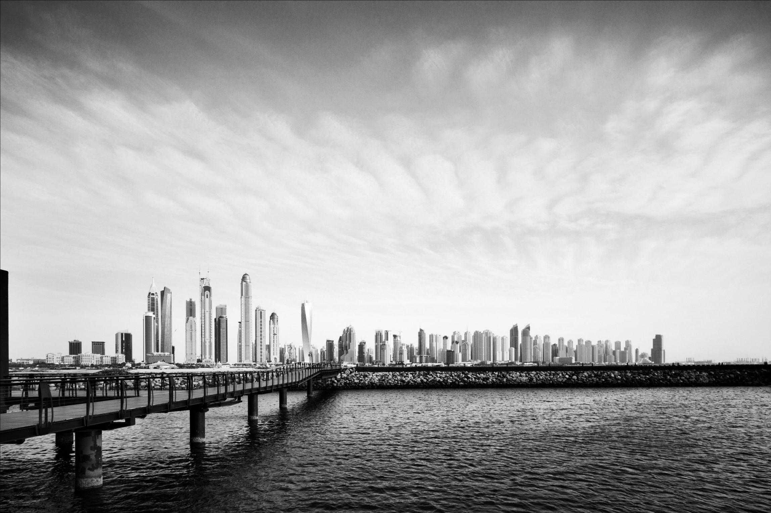
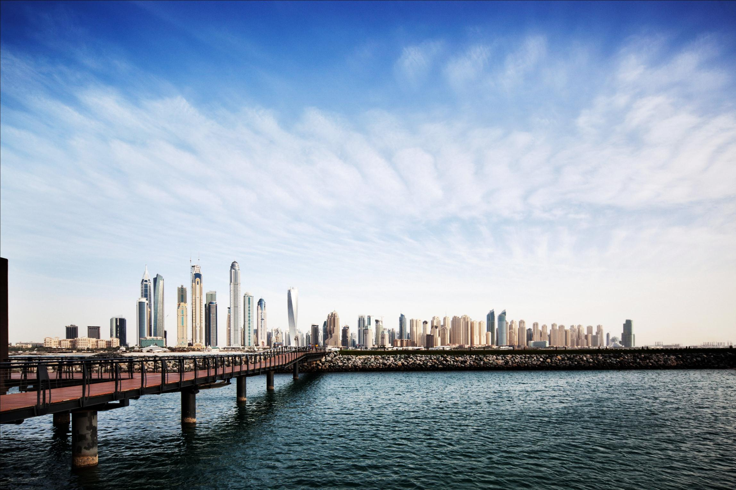
4th most visited city in the world
7.27 million overnight visitors in Jan-Jun 2016
13.77 million occupied room nights in Jan-Jun 2016
Where We Are Now
Tourism Vision

Slide 49
4th most visited city in the world
Record 7.2 million visitors in H1 2015
13.4 million occupied room nights in H1 2015
Where We Are Now
Tourism Vision

Slide 50
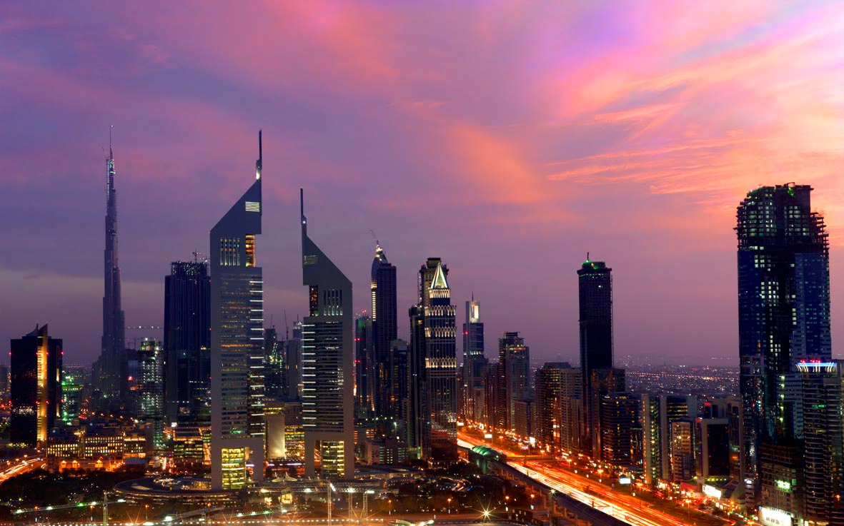
24th in Travellers’ Choice 2015 Destinations list
Crystal Award – for hosting 14,500
Nu Skin attendees
In top 20 safest cities in the world
4th most visited city in 2015 MasterCard Global Destination Cities Index
Most preferred overseas destination for Indian travellers
Dubai International named ‘Airport of the Year’
2014 World Festival and Event City Award
In top three most popular destinations among high-net-worth Chinese travellers
Accolades
Destination Offering

Slide 51
“
“
Our Value Proposition
Shopping
Gastronomy &
Night life
Events &
Festivals
Family
Outdoor
Culture:
Heritage
Culture:
The Arts
Hotels &
Spas
Infrastructure
Destination Offering

Slide 52
Destination Offering

Slide 53
Hotels & Spas
Hotels & Spas
Destination Offering

Slide 54
With a portfolio of more than 650 hotels and hotel apartment establishments and far more in the pipeline, Dubai caters to every type of guest
Hotels & Spas
Destination Offering

Slide 55
86 five-star, 96 four-star and 246 one- to three-star hotels 19 guesthouses and 214 hotel apartment establishments (Q1 2015 end)
Hotels & Spas
Destination Offering

Slide 56
Almost every global hotel brand has a presence, with more coming
Hotels & Spas
Destination Offering

Slide 57
State-of-the-art conference facilities
Hotels & Spas
Destination Offering

Slide 58
World-class spa facilities and services
Hotels & Spas
Destination Offering

Slide 59
Four Seasons Dubai Jumeirah Beach
Taj Dubai
Sheraton Grand Hotel, Dubai
InterContinental Dubai Marina
Hyatt Place Dubai – Baniyas Square
New Additions
Destination Offering

Slide 60
Palazzo Versace Dubai (Q4 2015)
Nikki Beach Resort & Spa Dubai (Q4 2015)
Total of 115,000 rooms expected by 2016
Royal Atlantis Resort (2017)
Coming Up
Destination Offering

Slide 61
Destination Offering

Slide 62
Infrastructure
Infrastructure
Destination Offering

Slide 63
Ideally positioned between East and West, Dubai offers world-class infrastructure and transportation links
Infrastructure
Destination Offering

Slide 64
Dubai International airport:
Serving 140 airlines flying to over 260 destinations across 6 continents
World’s busiest airport for international passengers – 70 million in 2014
Infrastructure
Destination Offering

Slide 65
Al Maktoum International Airport at Dubai World Central:
Phase one opened in October 2013
Passenger terminal capacity to expand to 26 million per year by 2017
Ultimate capacity of 200 million on completion
Infrastructure
Destination Offering

Slide 66
Jebel Ali Port – largest manmade port in the world
Infrastructure
Destination Offering

Slide 67
Dubai Cruise Terminal – largest cruise facility in the ME
Terminal 3 opened Dec 2014 – world’s largest dedicated cruise terminal
Home port to Costa Cruises, MSC, Aida and TUI, with Royal Caribbean International returning for 2015-16 season
Infrastructure
Destination Offering

Slide 68
Dubai Metro – world’s largest driverless network
Infrastructure
Destination Offering

Slide 69
SMART City:
Integrated NOC cards, mPay, Makani address system
Free Wi-Fi on Dubai Metro and via ‘Smart Palm’ stations
e-Ticketing, e-Permits & e-Gates
Infrastructure
Destination Offering

Slide 70
Dubai Tram (Nov 2014)
Dubai Trolley (Apr 2015)
New Additions
Destination Offering

Slide 73
THANK YOU

